Slide 1
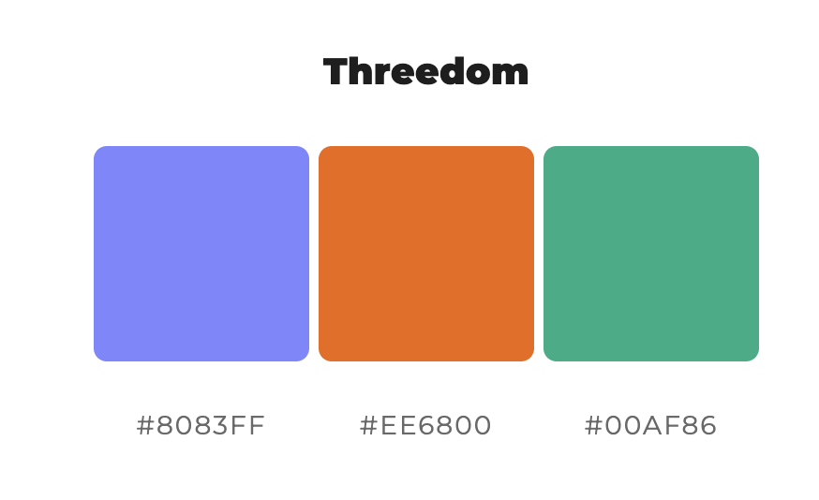
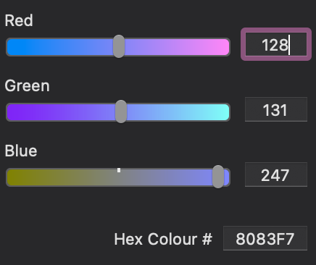
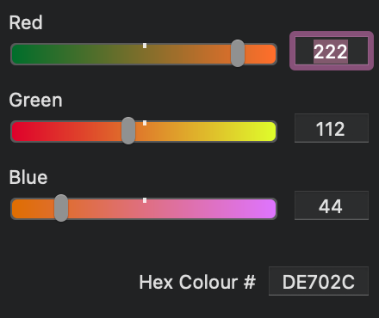
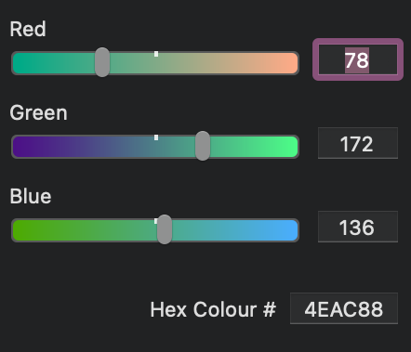
Colours to use

Slide 2


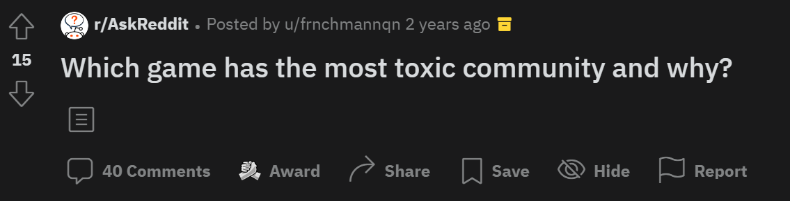
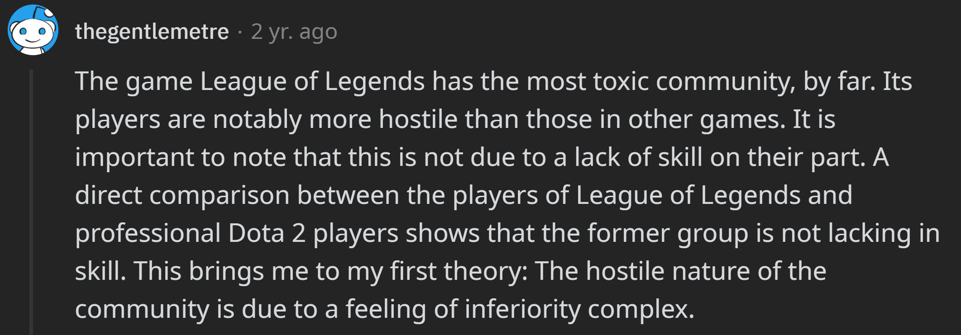
Findings
2 min
1. Hold on, am I talking to a chatbot?
2. Tutor: “Did you write all this by yourself?”
🤖Evil bots: Suicidal and devil thoughts,
False medical suggestions, etc.
📌Keyword: Trustworthy AI
😨Jobless: Labour market disruption,
Family’s financial crisis, etc.
🥳Keyword: Big thinking map
Ask ‘thegentlemetre’ on Reddit:
https://www.reddit.com/user/thegentlemetre
Play Copilot on GitHub:
https://github.com/features/copilot/

Slide 3
Stakeholders
Who are the stakeholders?
How are they involved?
1 min
Stakeholder diagram

